Slide 1
Underwater Simulation
By: Matthew Haley

Slide 2
Original Project Idea
Wanted to do something with the ocean and sea life

Slide 3
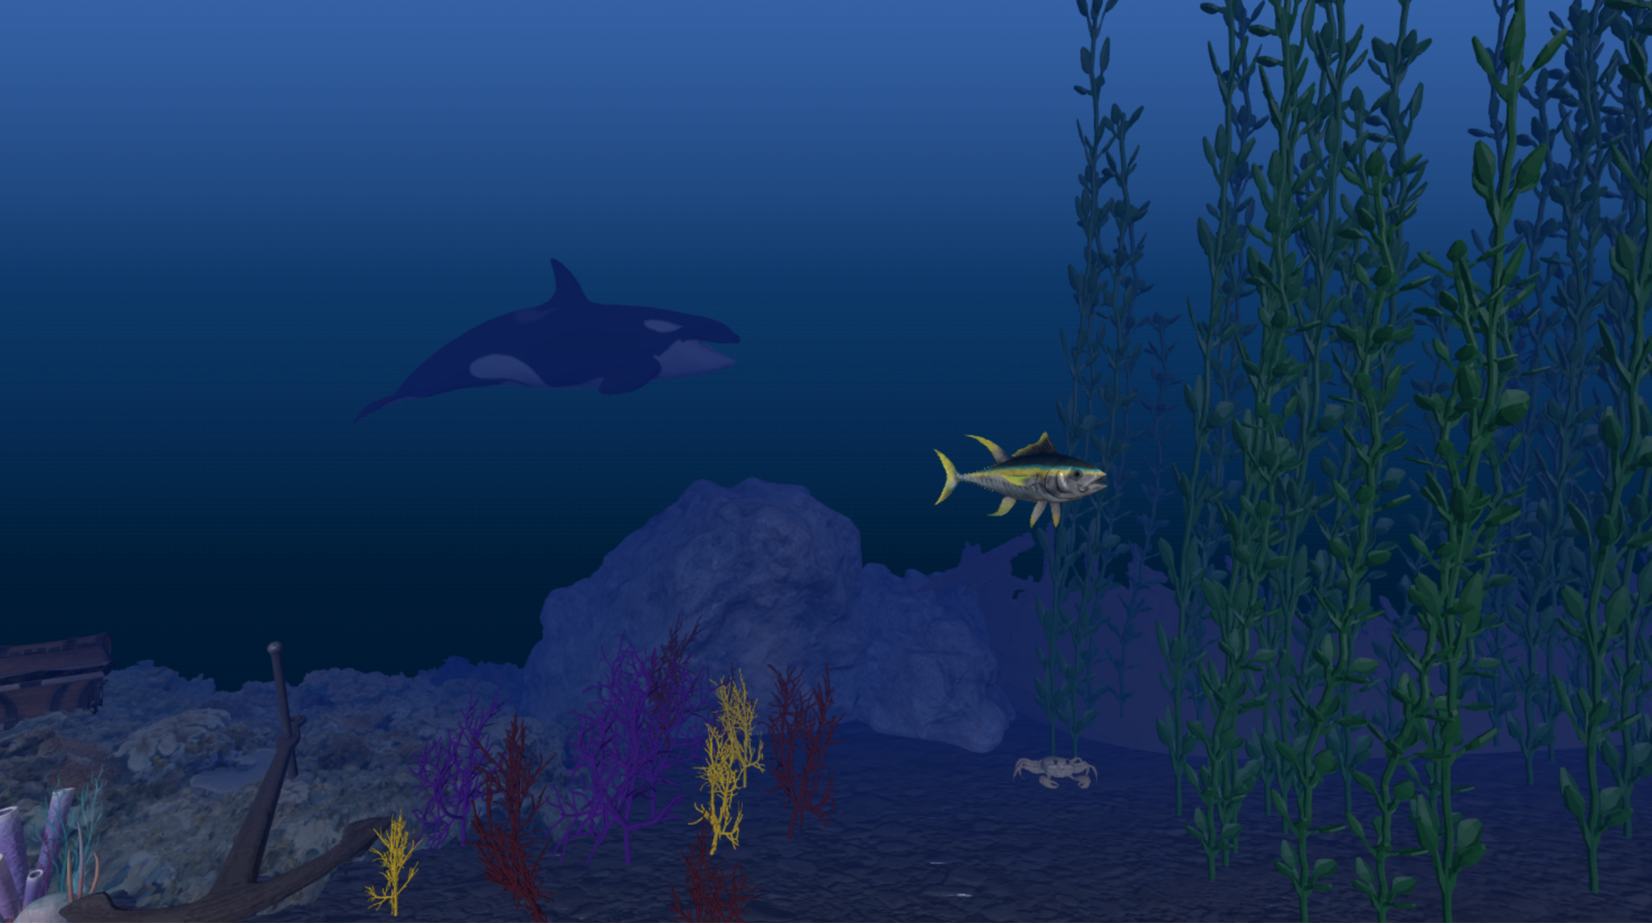
State Of Project

Slide 4
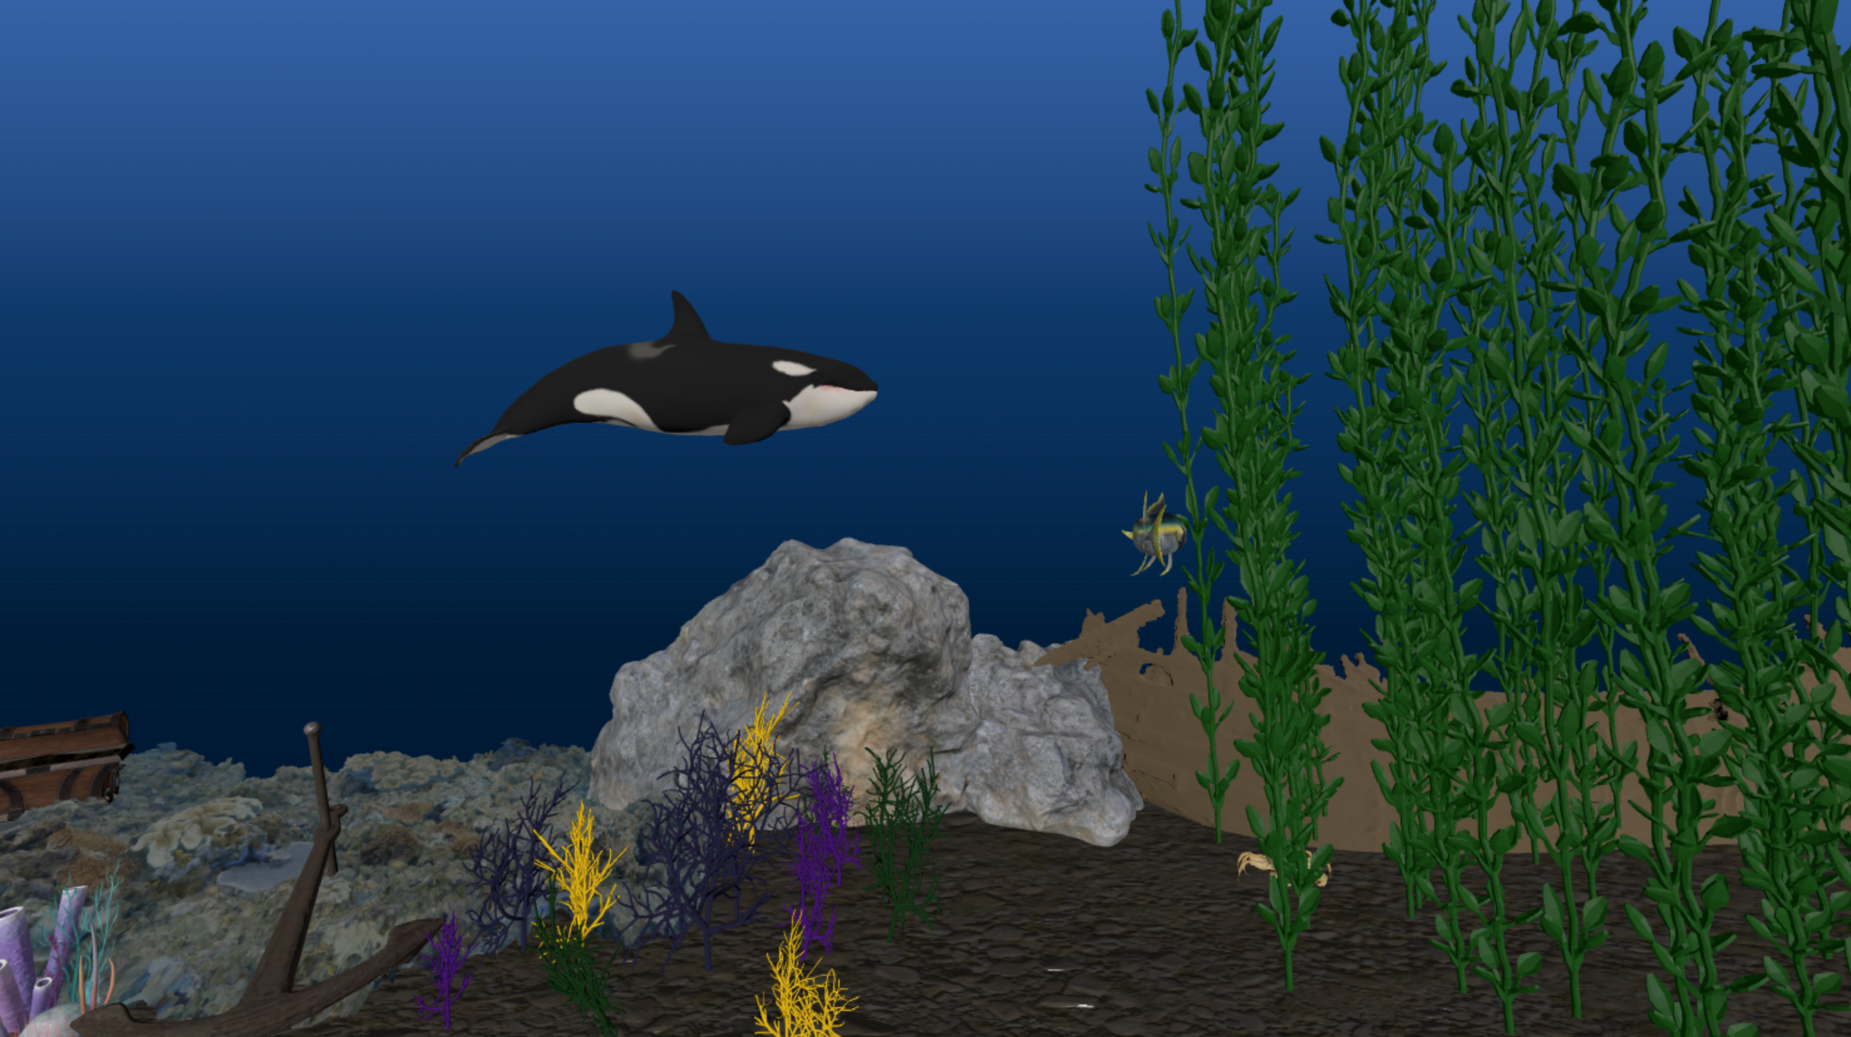
Learning Perspectives
Learned how to use three.js
Largest challenge was trying to make sea life move naturally and not get stuck on boundaries
Coolest moments were seeing the effect that the fog added and implementing delta time.

